Slide 1
AIT-664-Final Project Data Analysis for H1-B Visa (2011-2018)
Submitted By: Patriots 2
Garima Oswal
Jahnavi Jonnalagadda
Vardan Chennupati
Under the guidance of Prof. Hemant Purohit

Slide 2
CONTENTS
Overview
Data and Information Acquisition
Data and Information Preparation
Information Modelling and Visualization
Limitations
Conclusion
References

Slide 3
OVERVIEW
The aim of this project is to perform data analysis to provide insights on H1B dataset using Excel, R studio, Python, presenting visualization on Tableau.
This dataset is collected from The Office of Foreign Labor Certification (OFLC) which includes data from 2011-2018 worth 8 years of H-1B LCA petition, with more than 4 million records. The columns in the dataset include the status of the case, employer name, workplace coordinates, job title, prevailing wage, occupation code and filed year.

Slide 4
KEY TERMS
H1-B Visa
The H1B visa is a non-immigrant visa for temporary workers dependent on jobs. For this visa, an employer must offer a job in the U.S. and apply with the U.S. Immigration Department for your H1B visa application. This approved application is a work permit that enables you to receive a visa stamp for that employer and work in the U.S.
The Office of Foreign Labor Certification (OFLC) publishes H-1B disclosure data annually

Slide 5
Contd..
XGboost Algorithm
It is a decision-tree-based ensemble Machine Learning algorithm that uses a gradient boosting framework. The library is laser focused on computational speed and model performance, as such there are few frills. Nevertheless, it does offer a number of advanced features.
Algorithm Features
The algorithm implementation was designed to make compute time and memory resources efficient. A development goal was to make the best use of the resources available to train the prototype.
Some key features of implementing algorithms include:
Sparse implementation of Aware with automated handling of missing data values.
Block Structure to enable tree building parallelization.
Continued training to further boost a new data model that has already been fitted.
Model features:
The model implementation supports scikit-learn and R implementation features, with new additions such as regularization. Support is provided for three main forms of gradient boosting:
Gradient boosting algorithm also called gradient boosting machine including learning rate.
Stochastic Gradient Sub-sampling per split level in the row, column, and column.
Regulated gradient boosting with regularization of both L1 and L2.

Slide 6
Questions to be answered
Is the number of petitions with job title “Data scientist” increasing over time?
Which employer files the highest petitions each year?
Which part of the US has the highest number of data scientist positions?
What are the top 10 hiring companies/employers?

Slide 7
WORK FLOW
Data Acquisition
Used Kaggle to Acquire dataset
Data Cleaning
Used Excel to Filtered out columns where there is incomplete/irrelevant data
R Language
Used R studio to perform extract, load and transform the cleaned data
Visualization
Used Tableau for visualization
Modelling
Used Xgboost algorithm in python

Slide 8
DATA AND INFORMATION ACQUISITION
Dataset:
H1B Dataset
Data Source URL:
https://www.kaggle.com/rakeshchintha/oflc-h1b-data
Data Size:
~4Mrecords*21 Attributes and the size of the dataset is 871 MB
Data File:
OFLC H-1B Program Data (2011-2018)
https://www.uscis.gov/working-united-states/temporary-workers/h-1b-specialty-occupations-and-fashion-models/h-1b-fiscal-year-fy-2020-cap-season

Slide 9
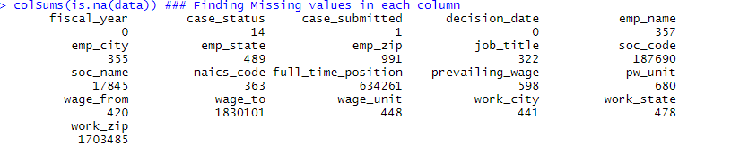
DATA AND INFORMATION PREPARATION
Initially our dataset has missing values for few columns.
We ignored the rows for which percentage of missing values of attributes is less when compared to the size of the dataset
For significant percentage of missing values like full time position, we identified that all the missing values are for year 2016 alone. Hence we visualized prevailing wage w.r.t to year by grouping full time position variable and decided to fill fulltime position as yes if prevailing wage >70k else no.
We have reduced dataset dimensionality by removing few insignificant columns like decision date, case submitted, emp city, emp zip, soc code, soc name, naics code, wage from, wage to, wage unit.
We have also removed duplicate columns like work city, work state, work zip also from our modelling.

Slide 10
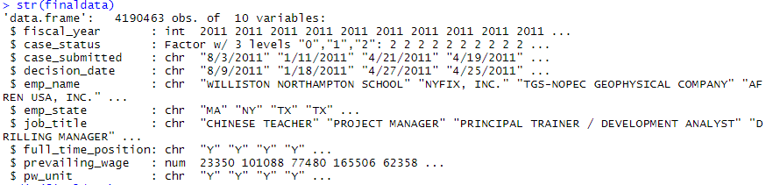
Contd..
Prevailing wage column has data in different formats. For example if pw unit has value M(Monthly), the prevailing wage column has monthly income in USD. To maintain the similarity, we have converted the income in terms of Year for whose pw unit is not yearly.
Our target variable case status, has four unique values C, CW,W,D
C: Certified, CW: Certified Withdrawn, W: Withdrawn, D: Denial. CW is included in Certified because technically certified withdrawn means applicant has decided to withdrawn his/her application after certified. With drawn is replaced with other category
For modelling purpose, we have converted these three classes into numeric values. 0: CW, 1: D, 2: Others
Clean data looks like below:

Slide 11
YOU WILL KNOW..
Which part of the USA has the highest number of H1-B filed?
Total number of H1-B applications filed in each year
Which Employer files the highest petitions each year?
Which job title has significant number of Job application filed for H1-B?
Which states has the highest wages for the Data Science job for H1-B holders?
Which months has the highest number of decisions given out every year?
What is the highest number of H1-B acceptance?
Which state has highest number of jobs and jobs related to Data field?
What is the highest denial rate for job title?

Slide 12
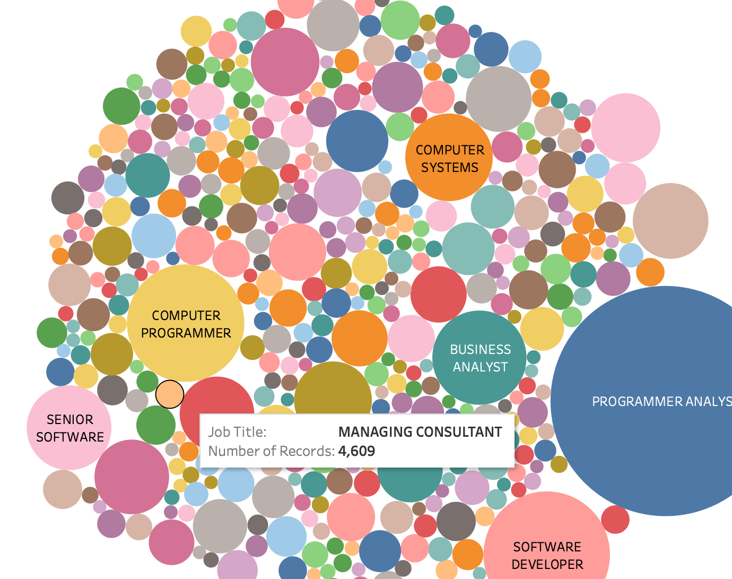
Visualization Using Tableau & Python For all our analysis we have not considered population of the each state and cost of living index of each state.

Slide 13
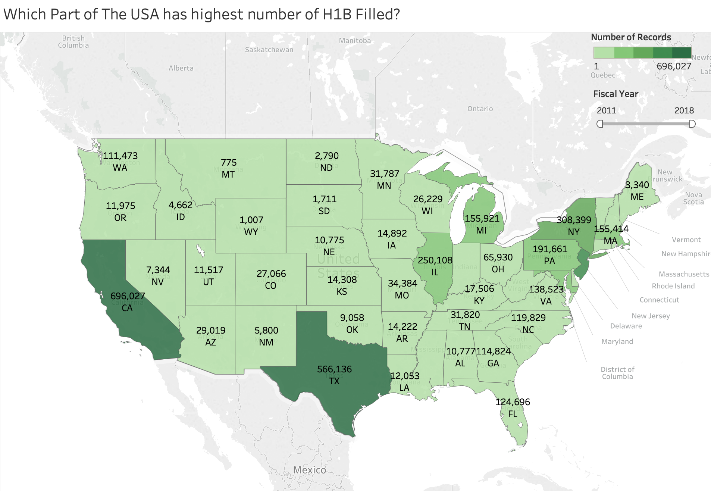
Which part of the USA has the highest number of H1-B filed in the year 2011-2018? (population is ignored)
2011-2018

Slide 14
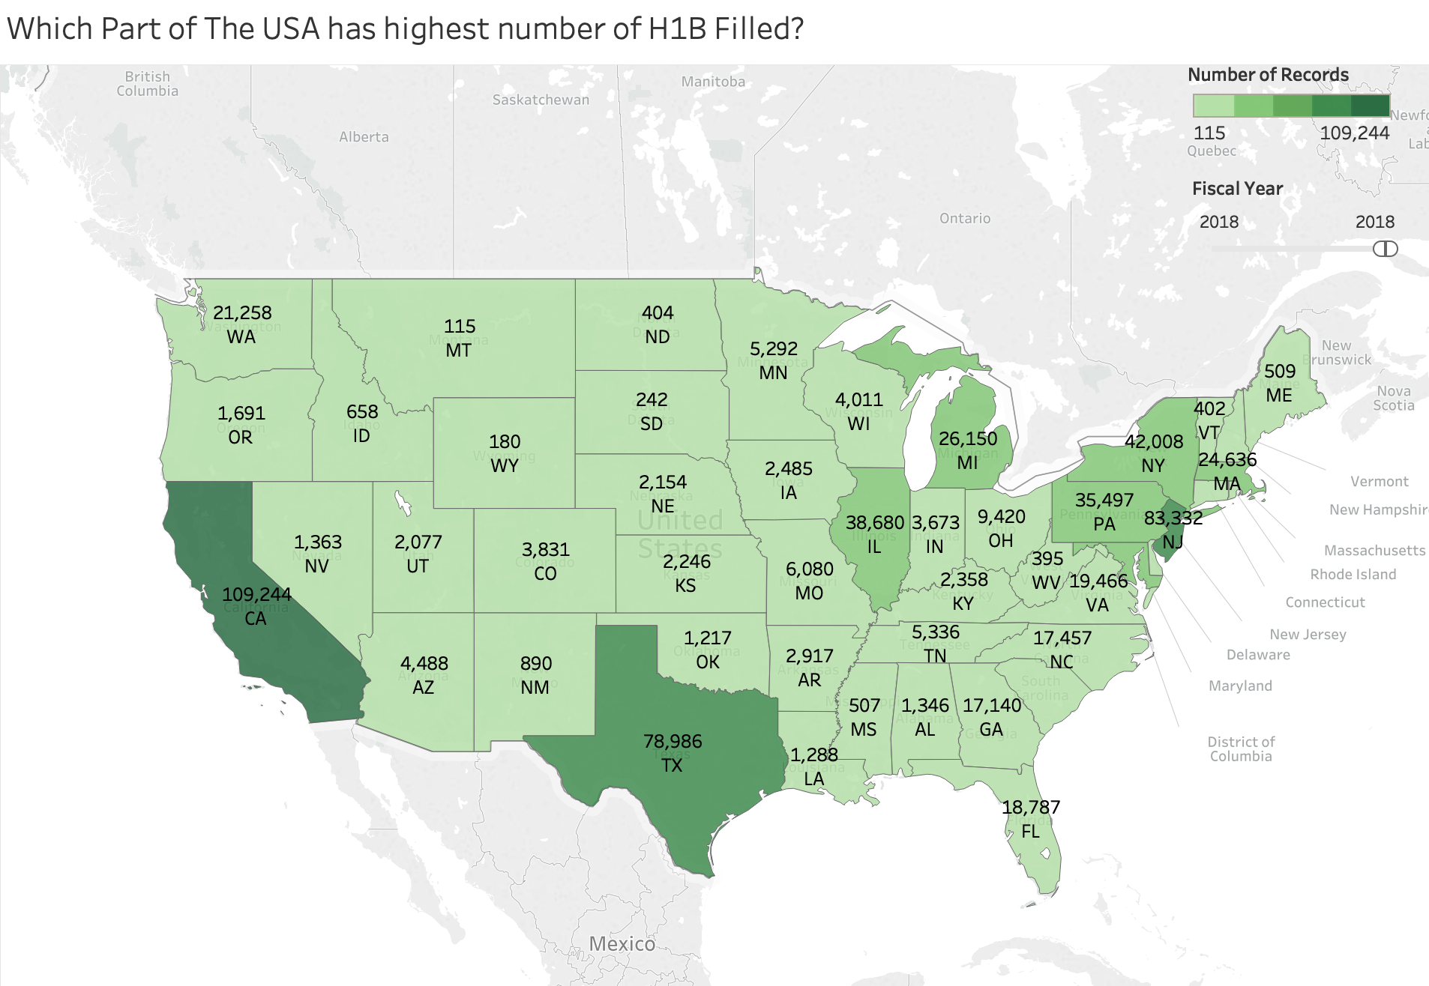
Year-2018
2011-2018

Slide 15
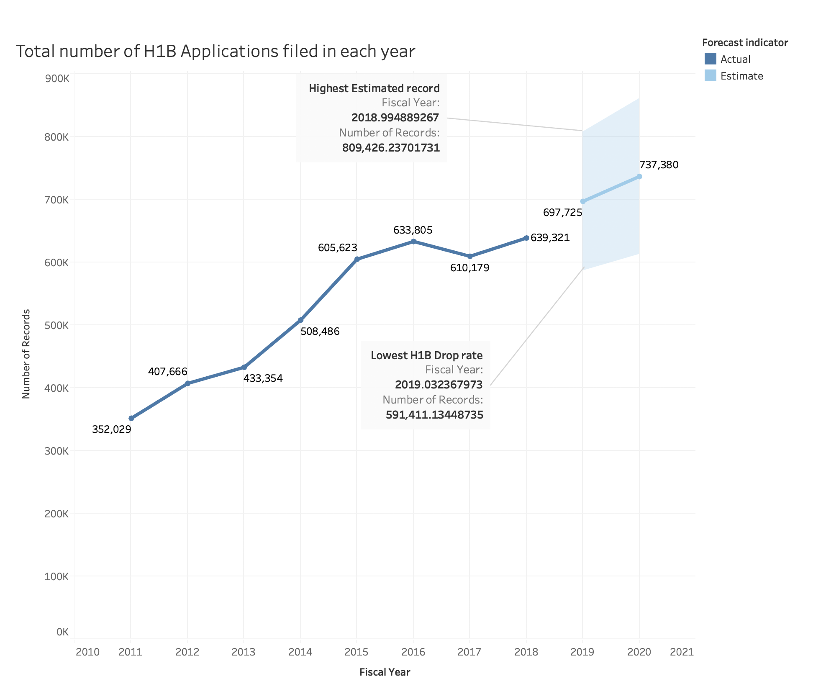
Total number of H1-B applications filed in each year
Predicted years 2019 - 2020

Slide 16
Total Number of H1-B applications filed in each year
**Population is not considered.

Slide 17
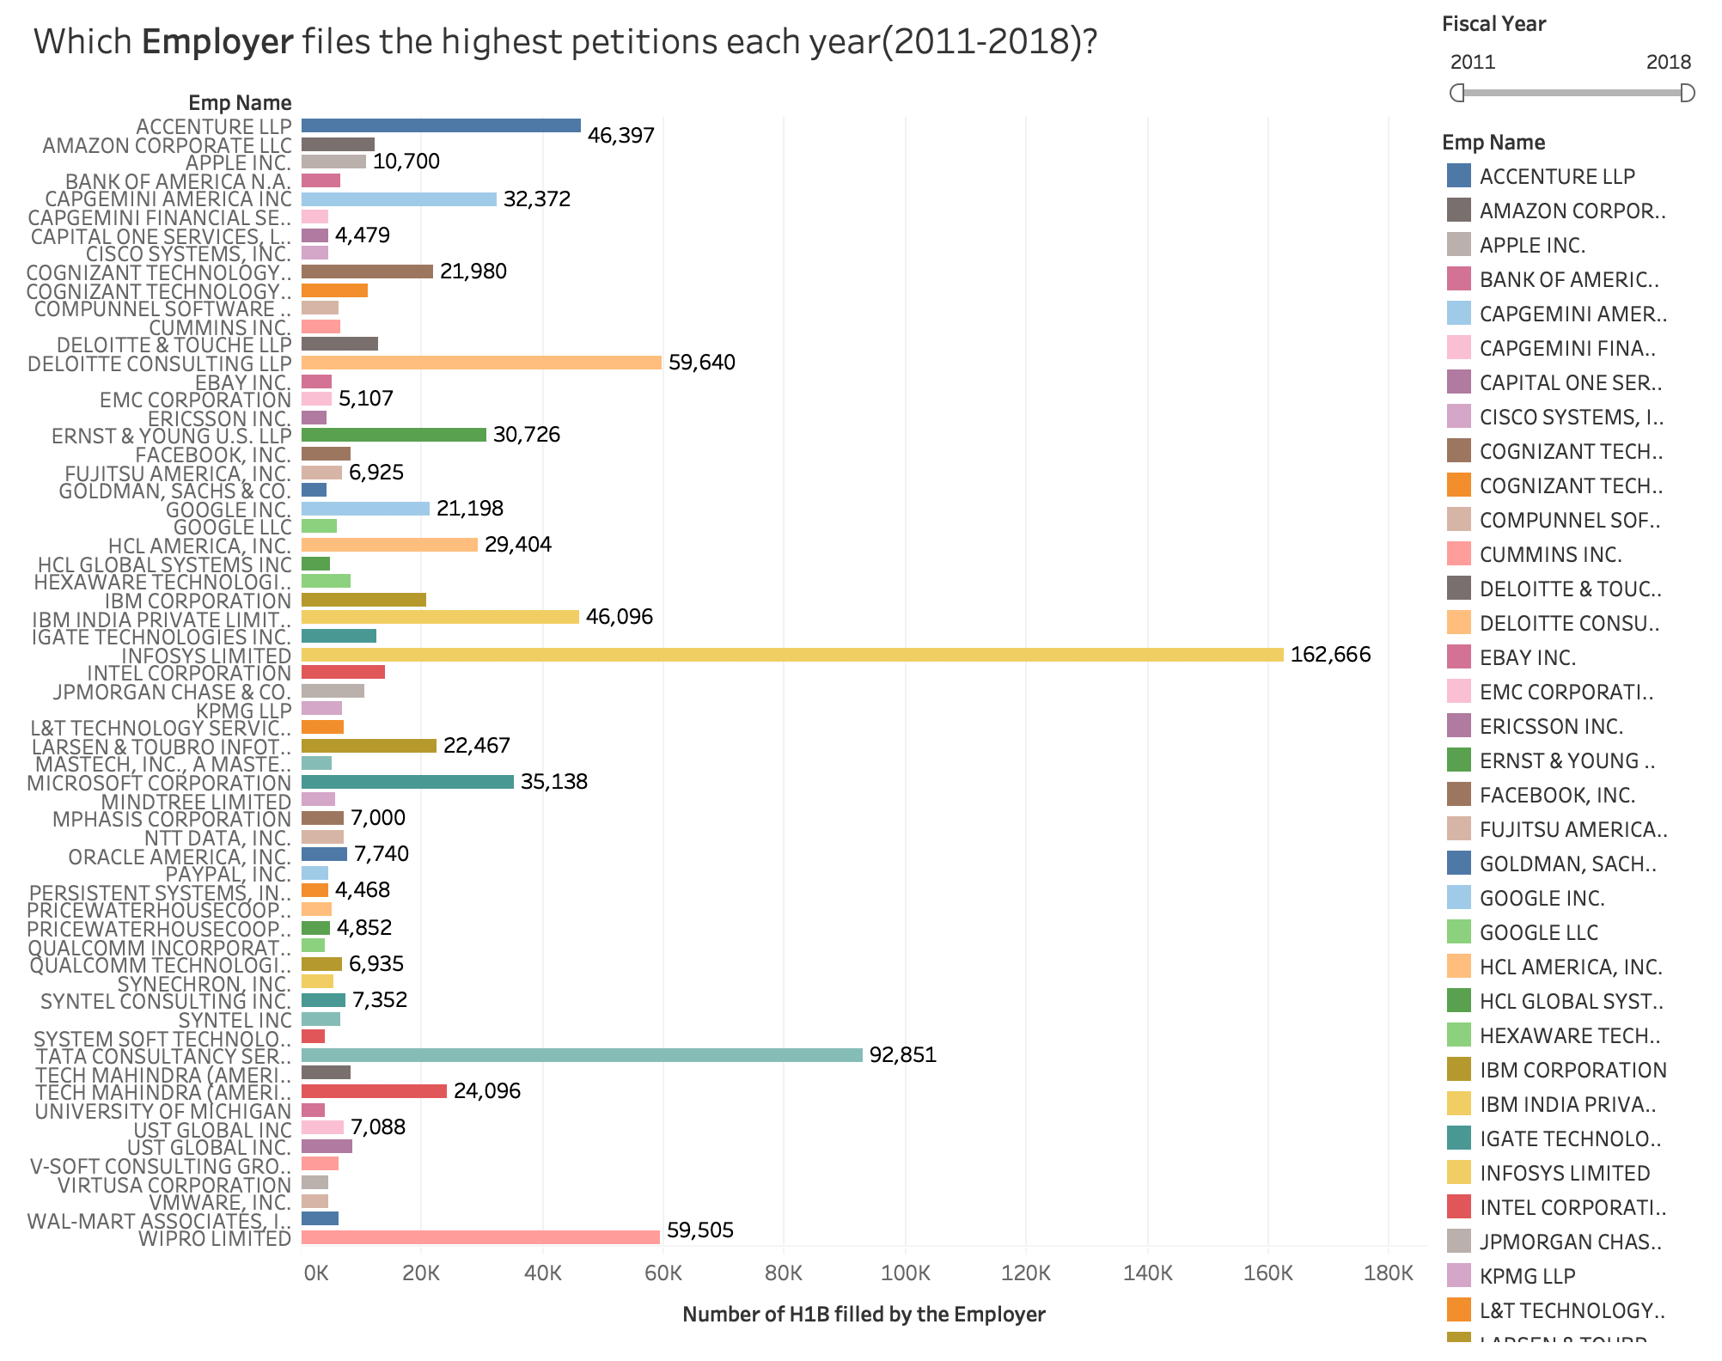
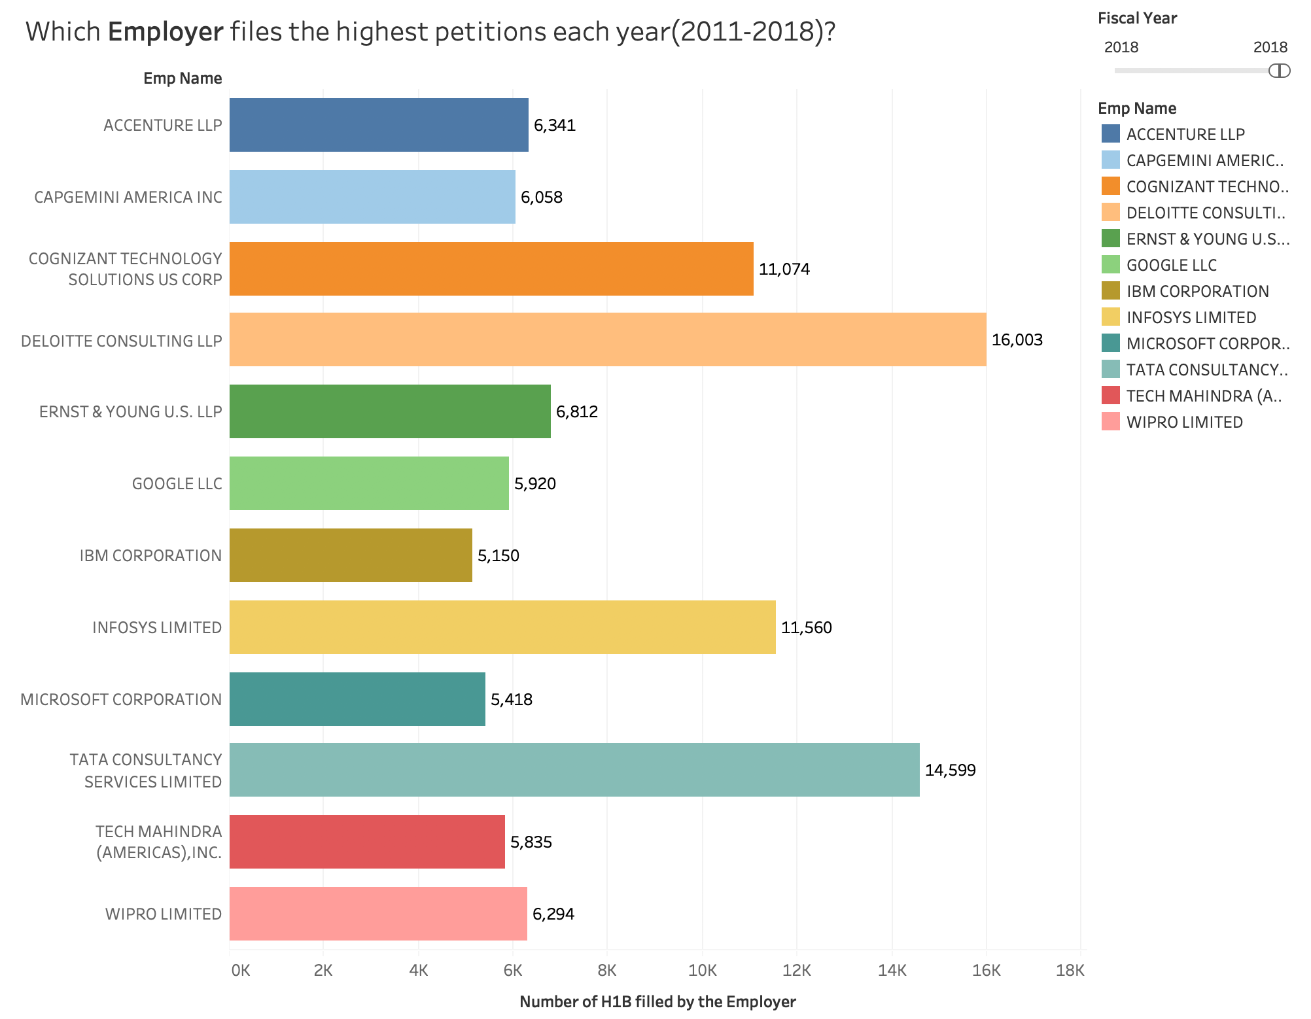
Which Employer files the highest petitions each year?
2011-2018
2018

Slide 18
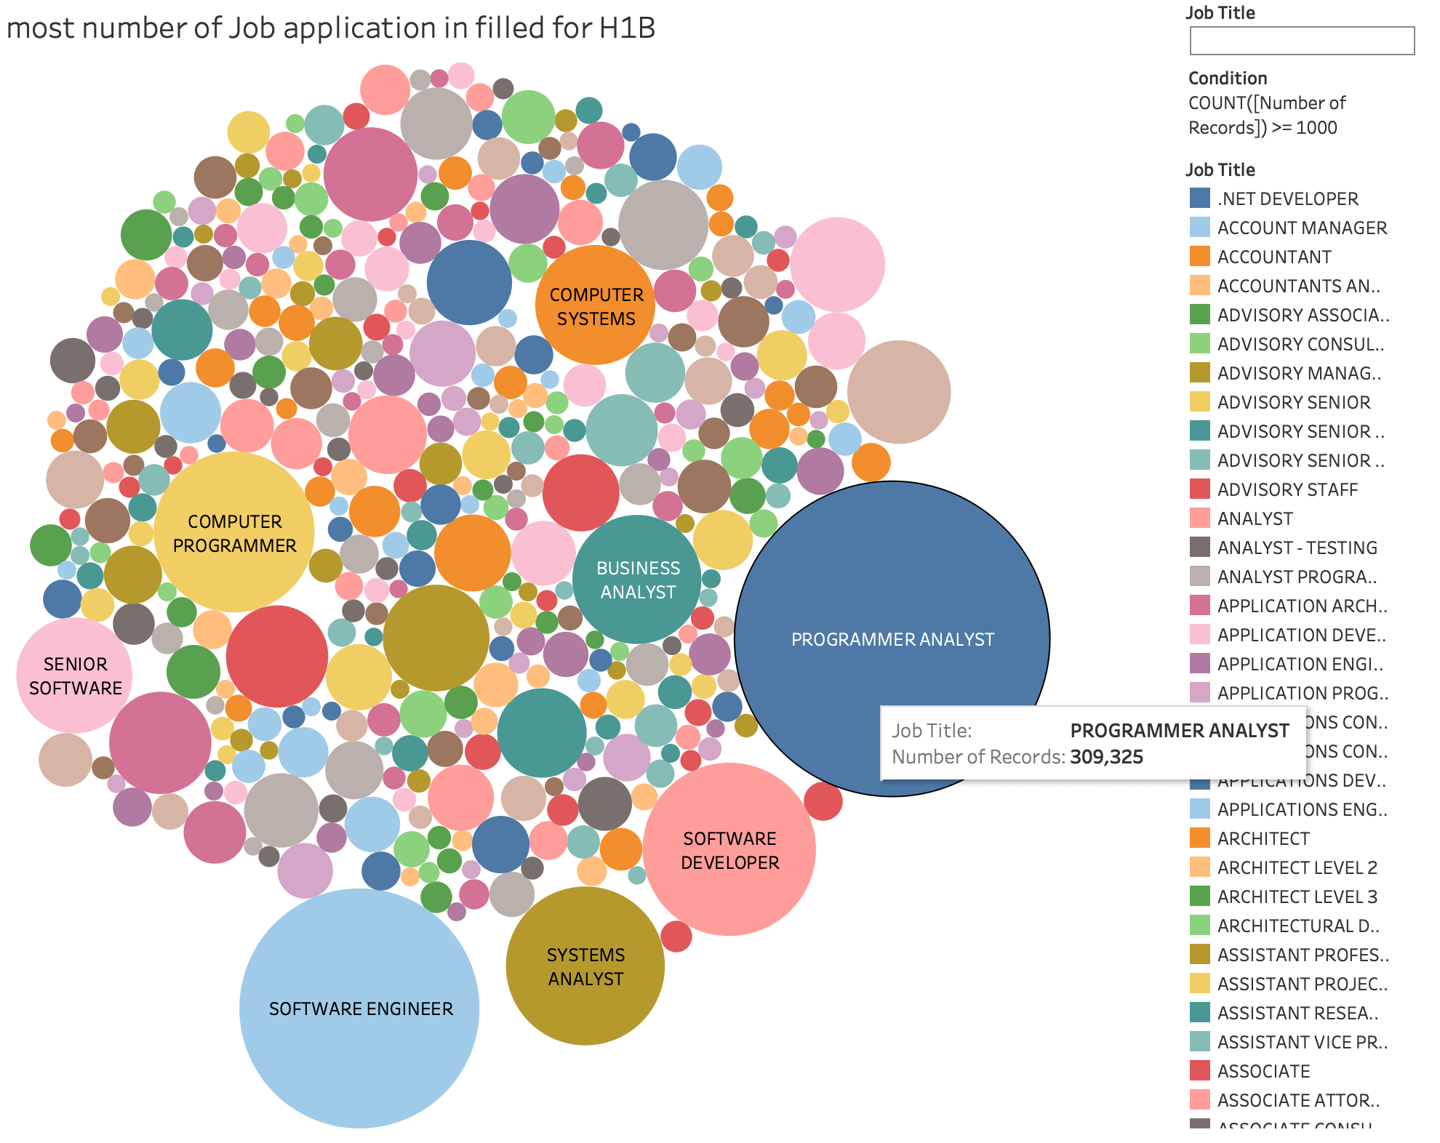
Which job title has significant number of Job application filed for H1-B?
2011-2018

Slide 19
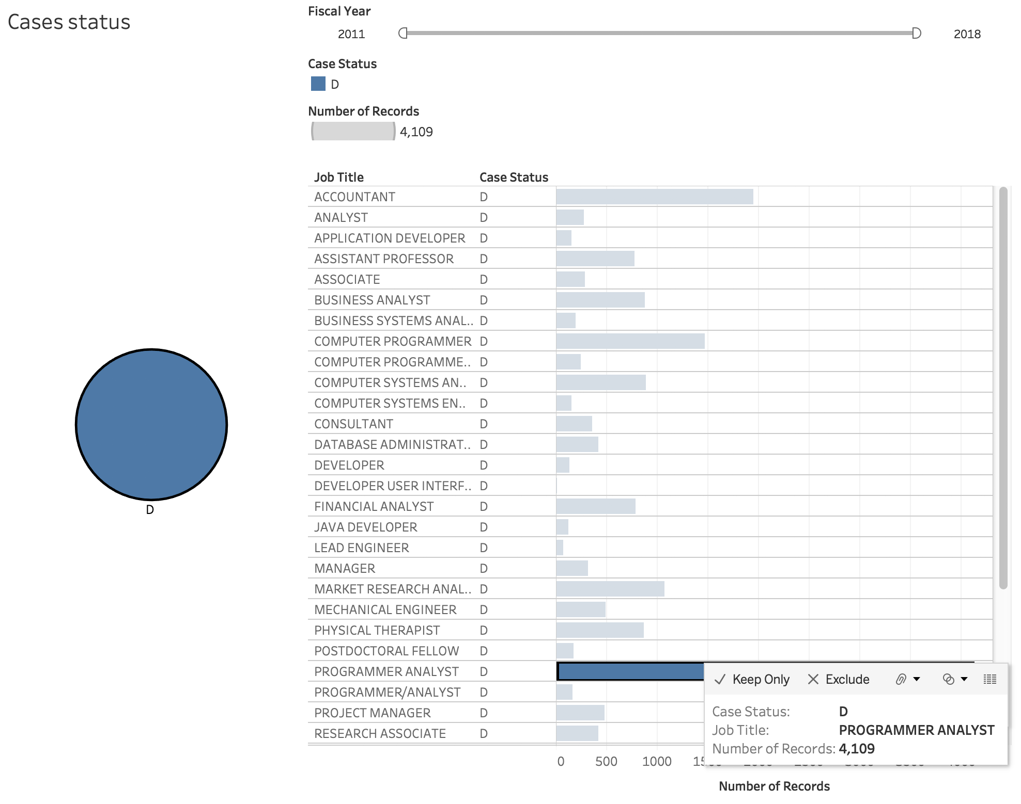
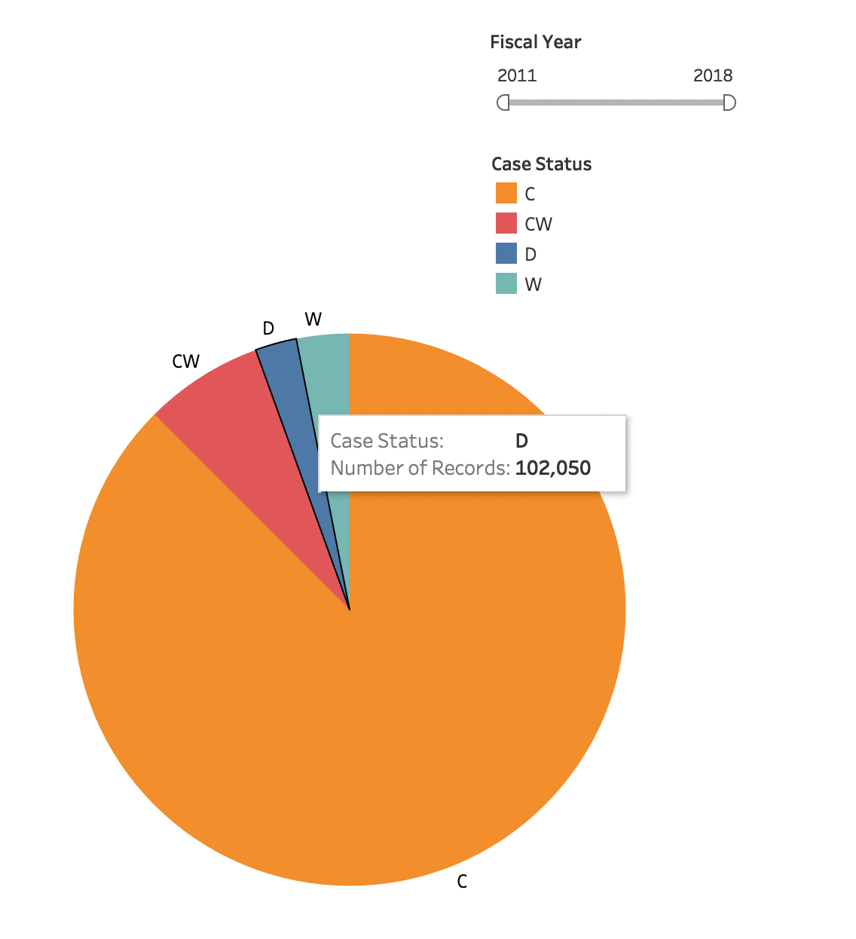
What is the highest denial rate for job title?

Slide 20
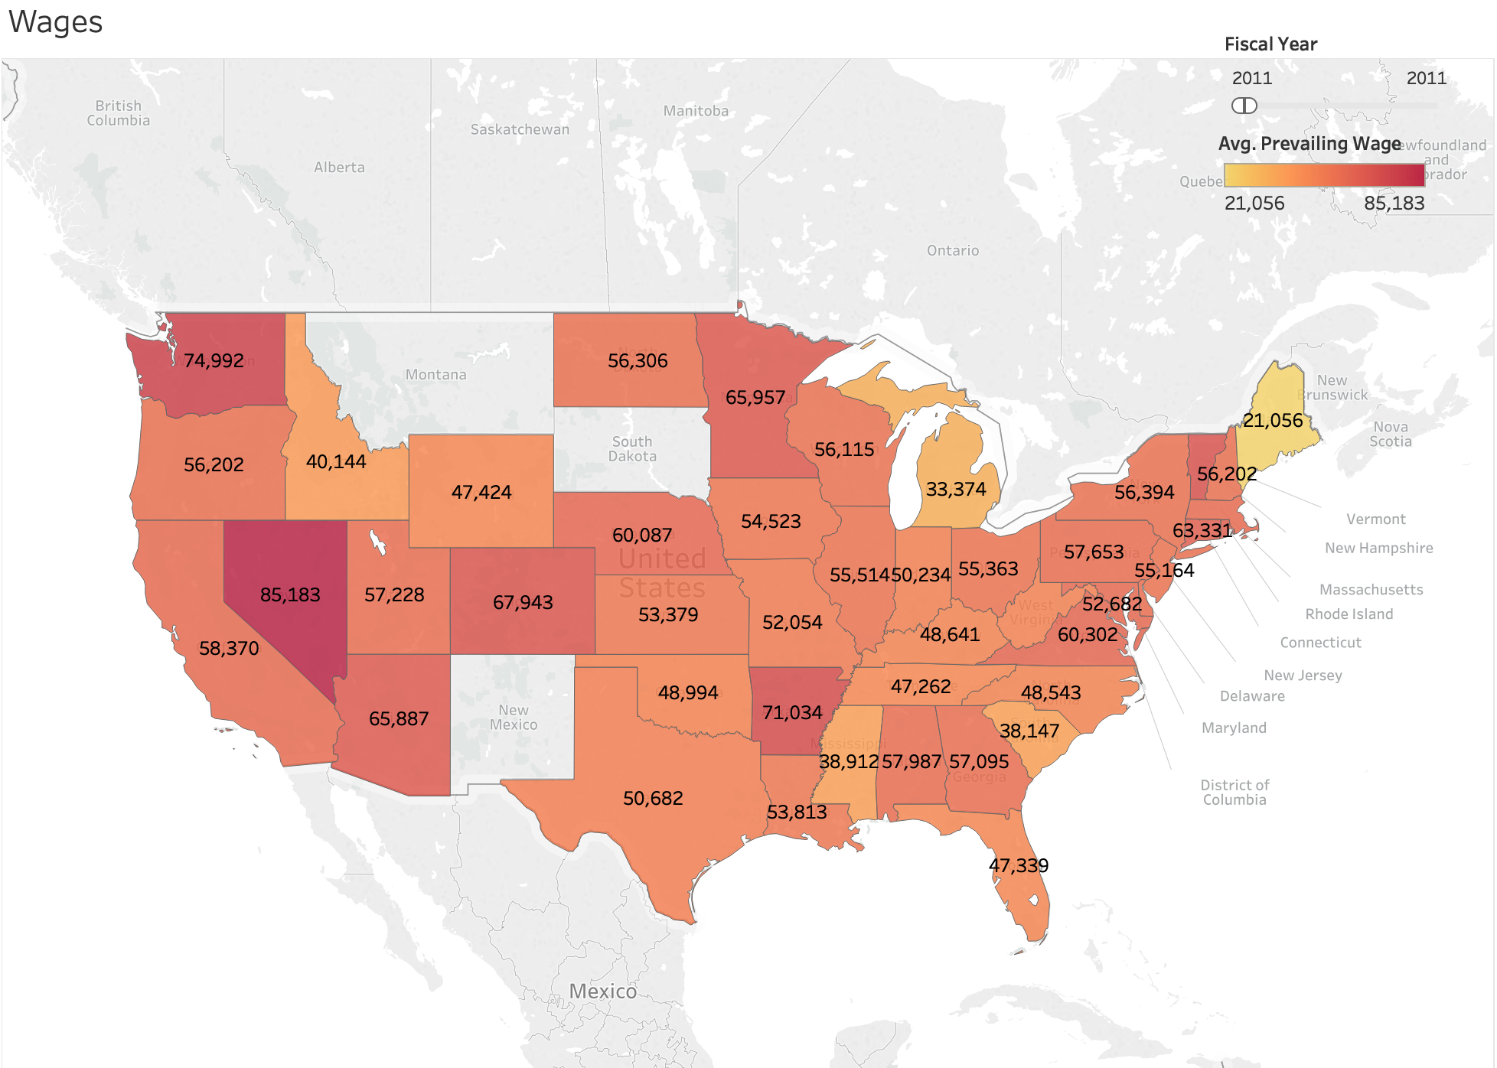
Wages in Year 2011 for the Data Science job
*Avg wages for data science
**Cost of living index is not considered
2011

Slide 21
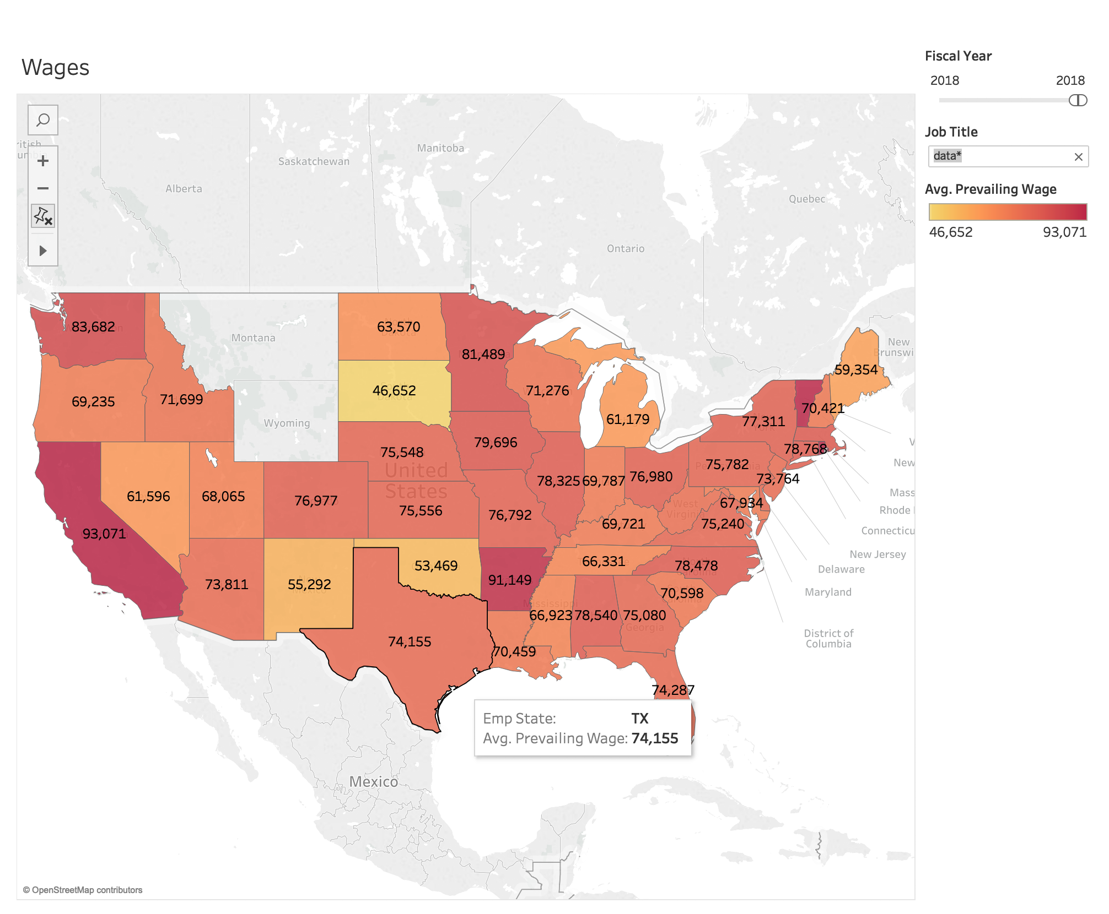
Which states has the highest wages for the Data Science job for H1-B holders?
*Avg wage
**Cost of living is not considered
2018

Slide 22
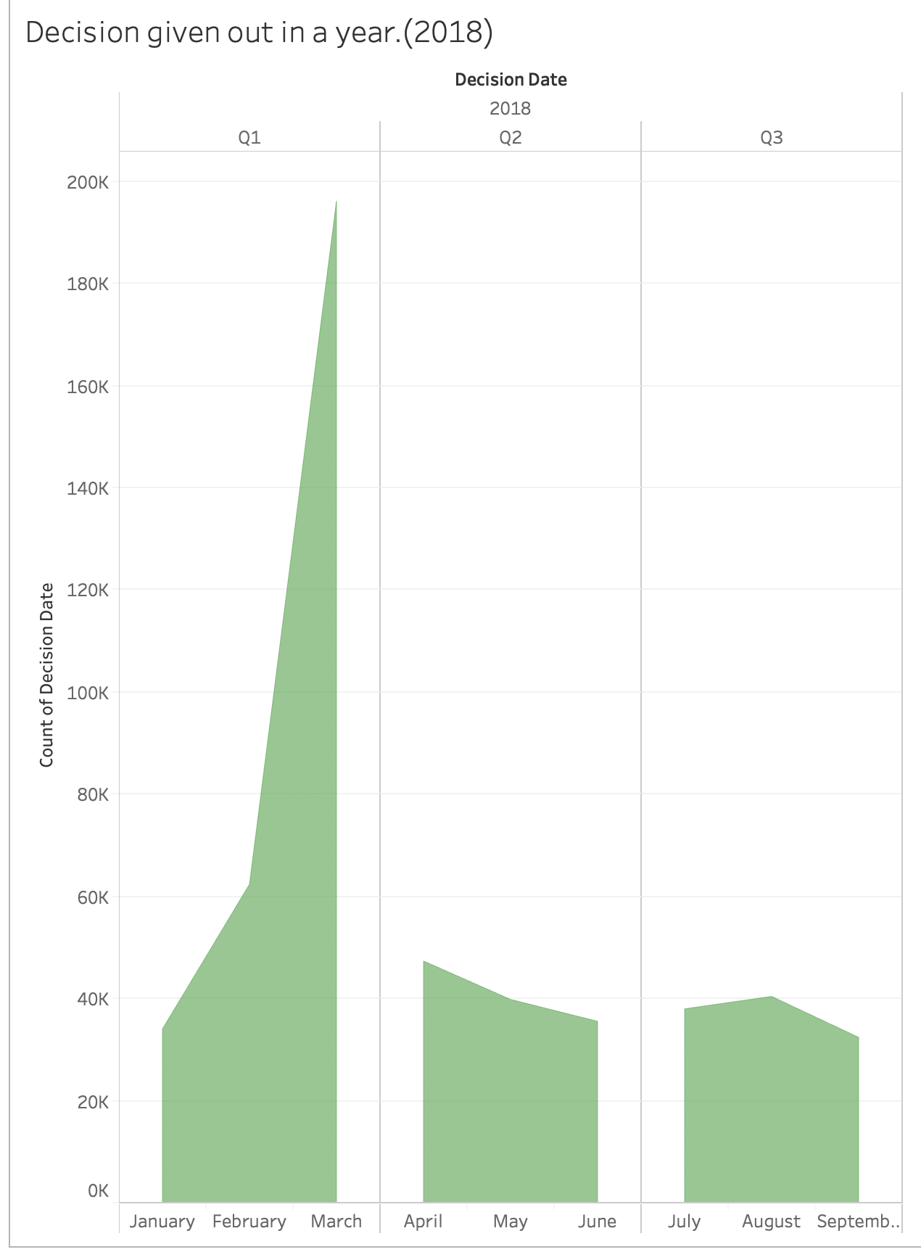
Which months has the highest number of decisions given out every year?

Slide 23
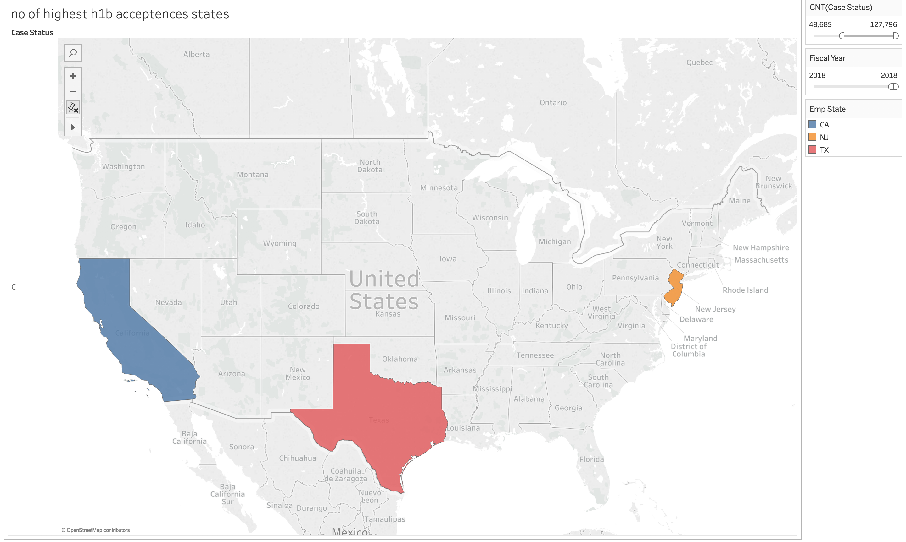
Which state has the highest number of H1-B acceptance? Population is not considered

Slide 24
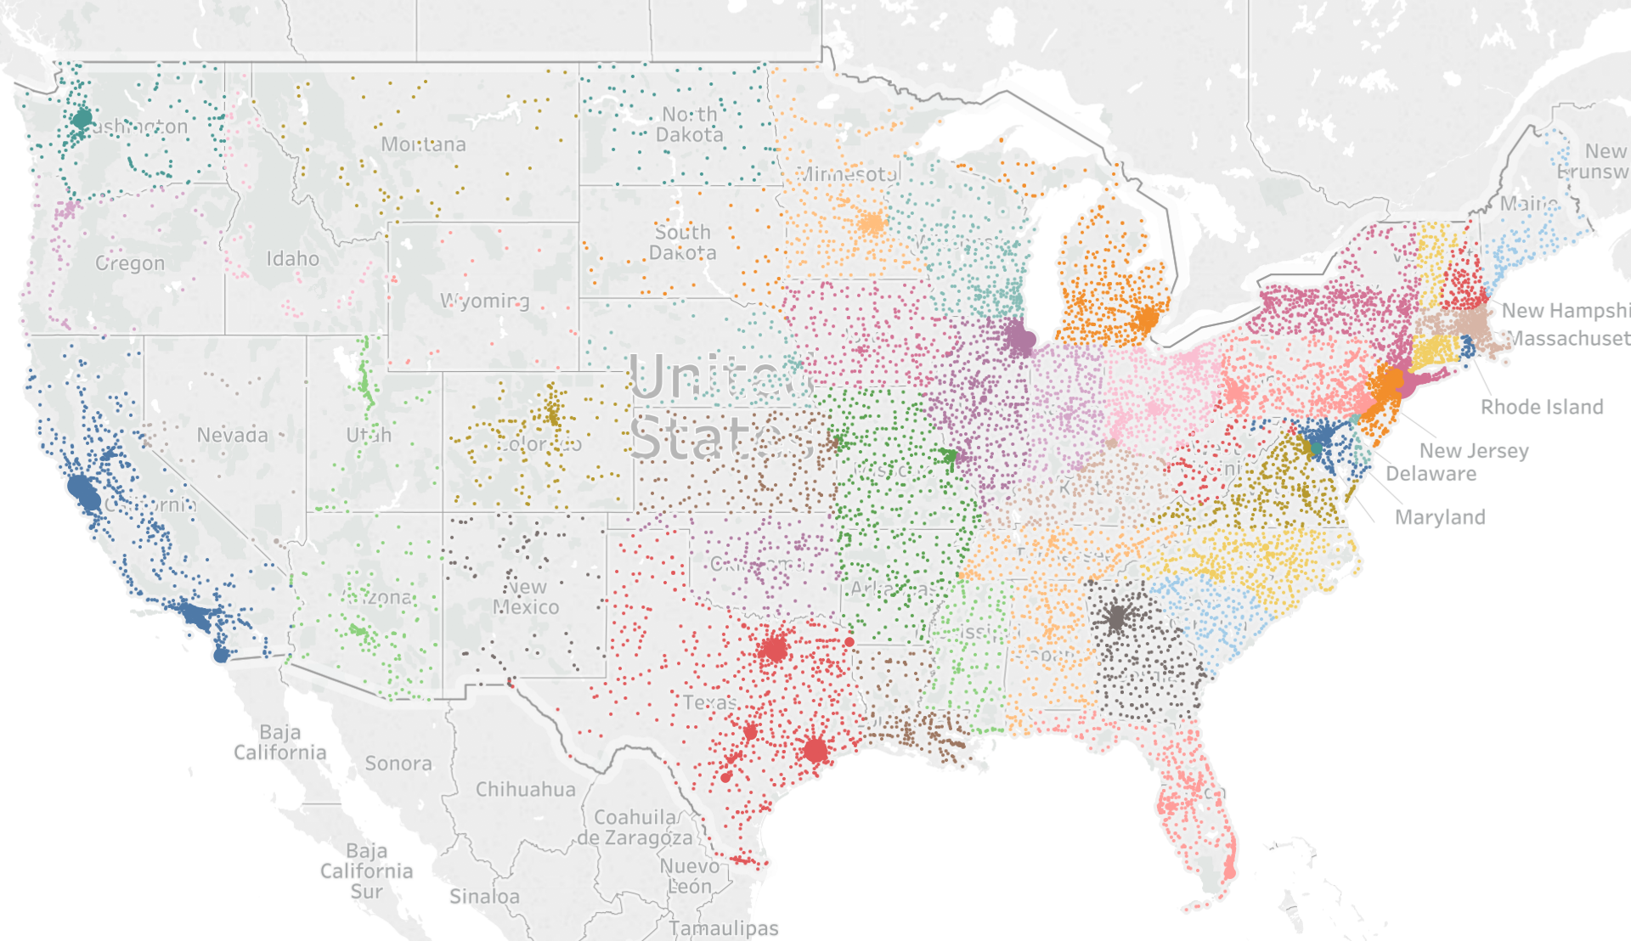
Full Time Jobs in the US (population is not considered)
2011-2018

Slide 25
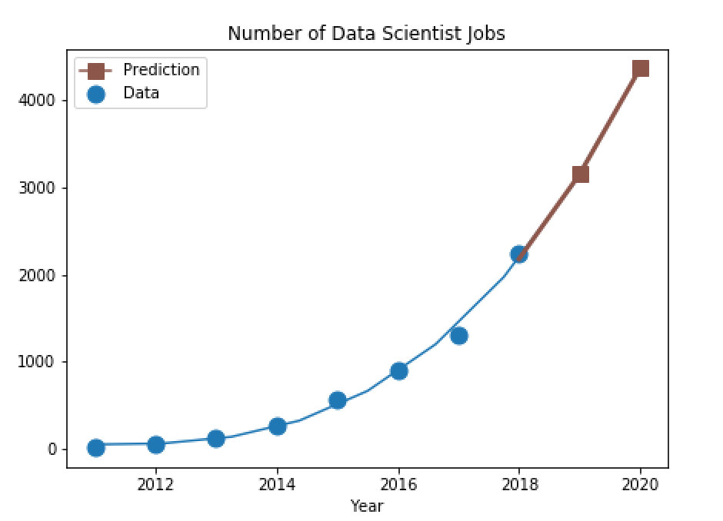
H1B for Data science
Forecasting job market for Data Science.
Exponential increase in number of Data Scientist jobs
*Using python

Slide 26
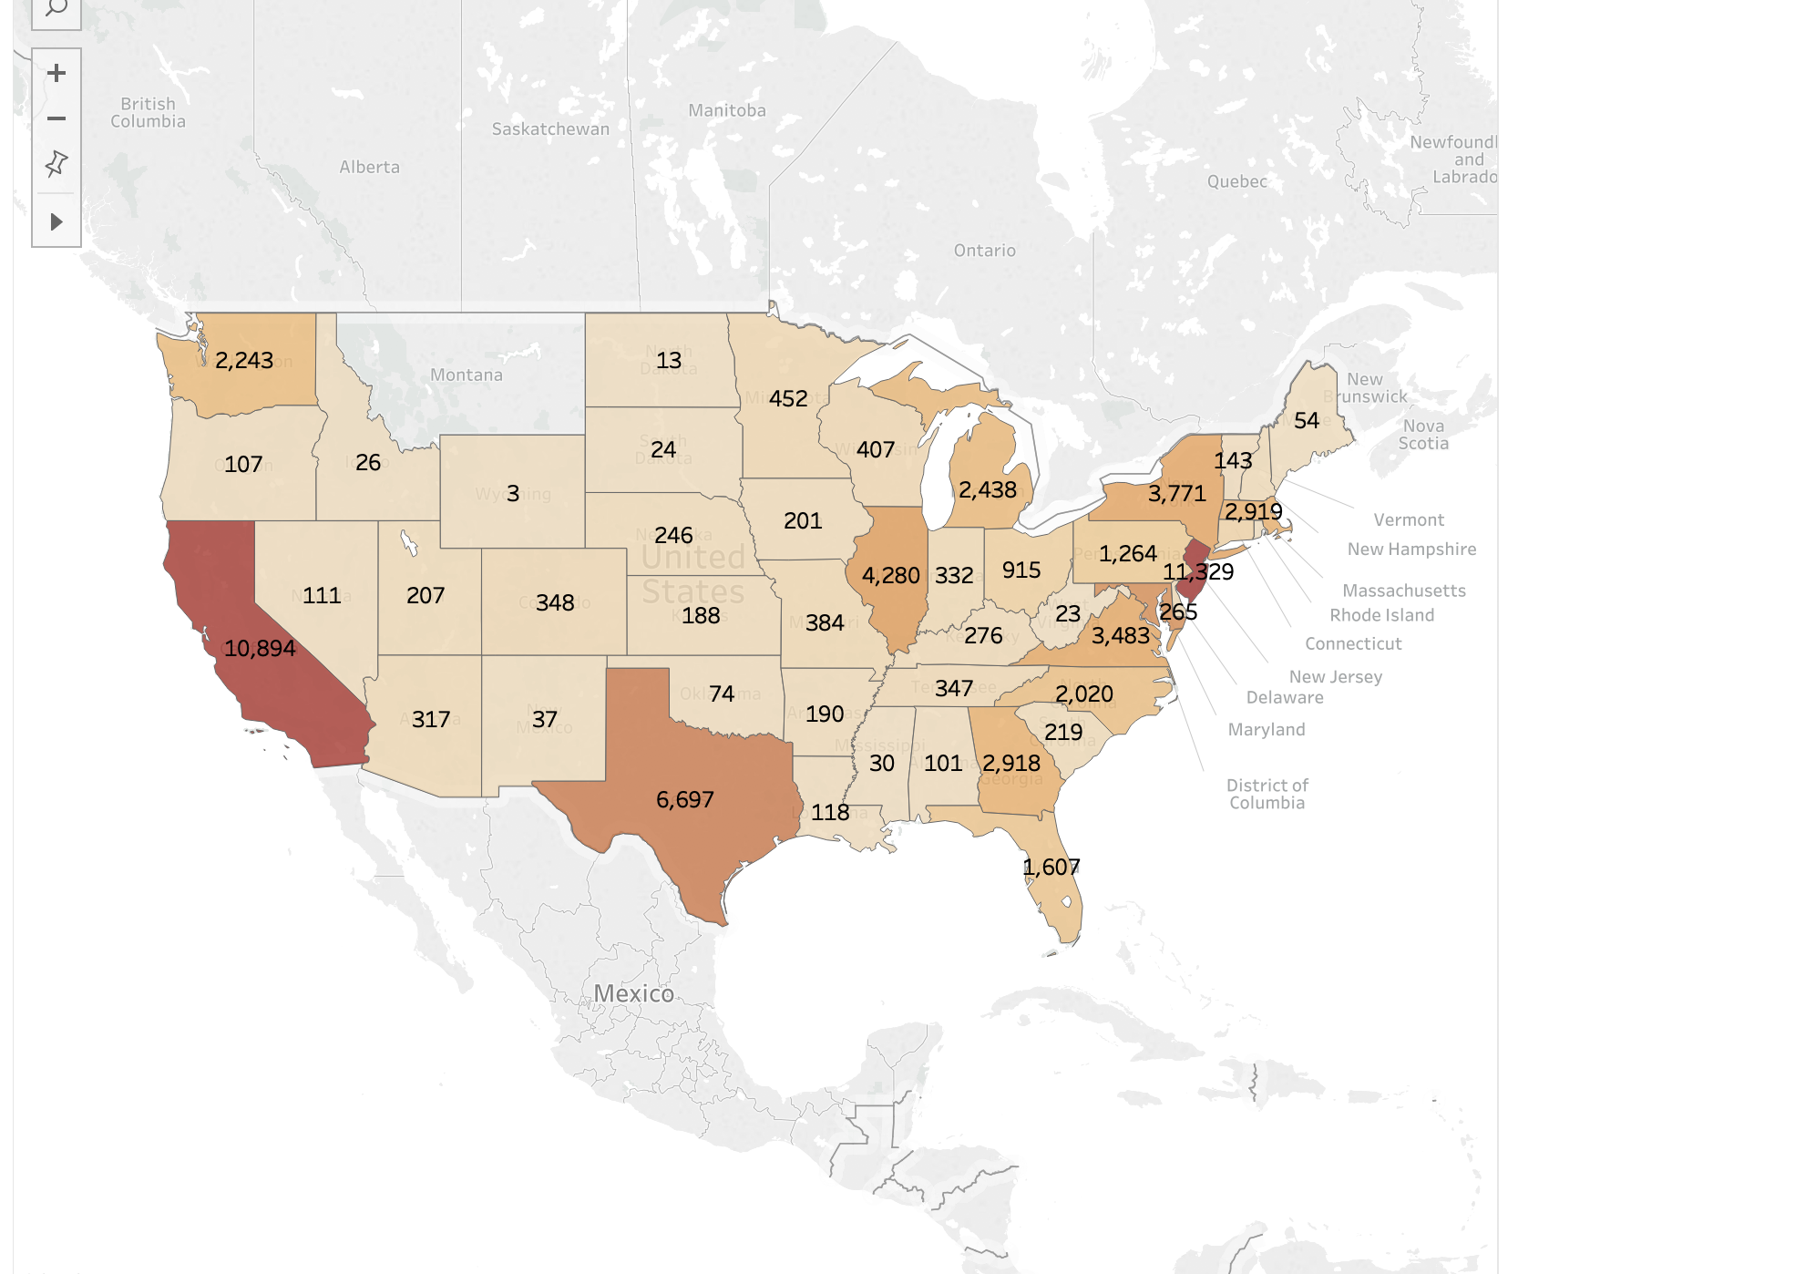
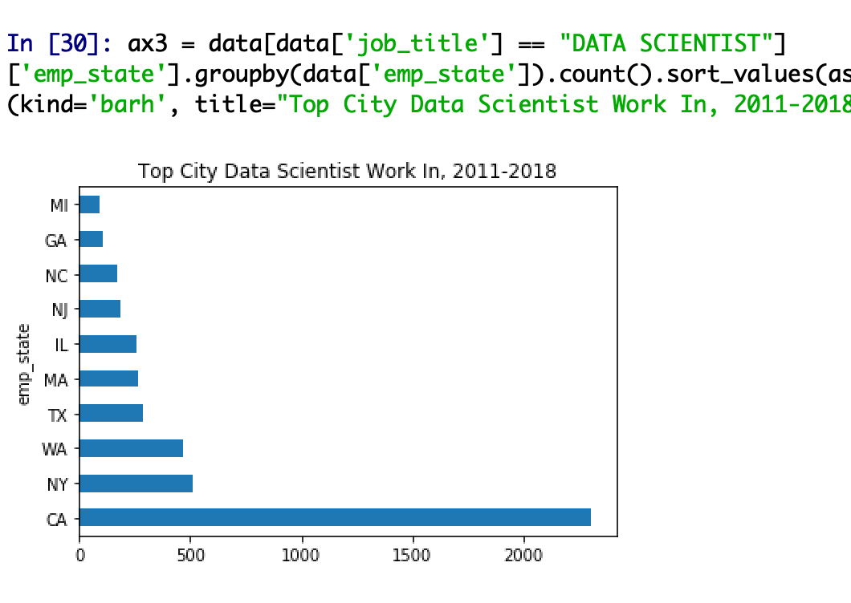
Which state has highest number of jobs and jobs related to Data field?
Tableau(Population ignored)
Python (Population ignored)

Slide 27
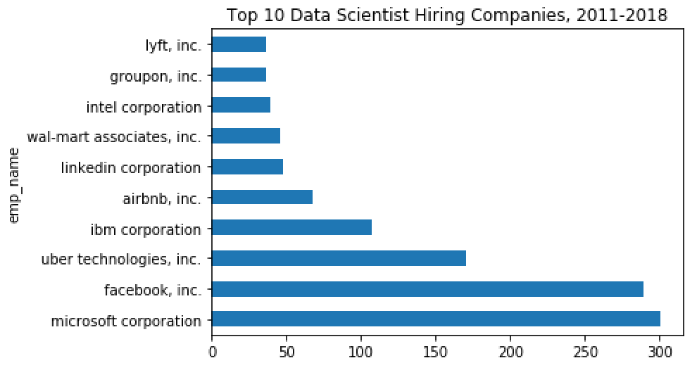
Which company has filled the highest number of H1B in the field of Data Science ?

Slide 28
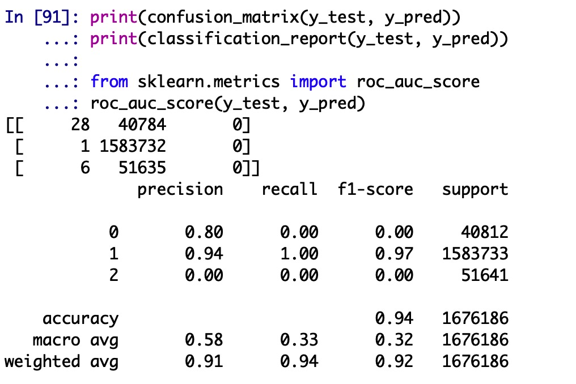
Modeling
XGBoost is also know as “ Extreme Gradient Boosting”, which is a supervised learning problem.
We have used the X to predict a target variable Y (Cases status)
Why we used XGBoost.
When it come to small –to –medium structured/tabular data, decision tree- based algorithms are considered best in class
This can handle missing values and regularization to avoid overfitting /bias
Faster compilation speed compare to random forest, gradient boosting and bagging.
It is a perfect combination of software and hardware optimization techniques to yield superior results using less computing resources in the shortest amount of time.
It penalizes more complex models through both LASSO and Ridge regularization to prevent OVERFITTING.
Model used for the dataset XGBoost
Execution Speed
Model performance
Accuracy obtained
94%

Slide 29
CHALLENGES & LIMITATIONS
Apart from understanding the data, data cleaning was the most challenging task. There are many variables in the dataset that were not of our concern.
Also, the “Job Title” attribute has approx. 2 lakh unique values which is categorical variables and fewer continuous variables and factors and converting it to numeric need a lot of resources. It is precisely for this reason that we can not fit a model to predict the factors that affect the approval of applications for h1b visas. Therefore, creating a template to predict the visa application's progress would still be difficult.
One of the main reason is the data is biased as the decline class is only 3.2% of the total dataset, that means we have approx. 96.8% C (certified cases) in ours .This shows that the dataset is highly imbalanced. One of the problem with imbalanced dataset is that the model is more biased towards the class with high occurrence. In this cases it is towards C(certified cases).
As this dataset is biased towards one class, descriptive analysis gives more insights of data rather than predictive analysis.
Analysis done from this dataset doesn’t give any information about H1-B approval, instead it gives if the applicant is eligible to file H1-B petition.

Slide 30
Conclusion
California and Texas has the highest number of H1-B filed in 2018 year.
* The number of petitions with job title “data scientist” is increasing exponentially
* Infosys, Deloitte, TCS and Wipro are the top 4 employers with highest petitions each year.
Programmer Analyst has the highest number of job application filed for H1-B and hence it has the highest number of H1-B denial.
California state has the highest avg wages of up to 93,071, for the Data Science job for H1-B holder
March month has the highest number of decisions given out each year.
*California, New York and Washington has the highest number of data scientist jobs.
Microsoft and Facebook are the top two companies filed the H1-B for Data Science job.

Slide 31
REFERENCES
https://towardsdatascience.com/https-medium-com-vishalmorde-xgboost-algorithm-long-she-may-rein-edd9f99be63d
https://www.kaggle.com/nsharan/h-1b-visa
https://www.tableau.com
https://www.office.com/launch/powerpoint?ui=en-US&rs=US&auth=2
https://machinelearningmastery.com/gentle-introduction-xgboost-applied-machine-learning/
https://www.uscis.gov/working-united-states/temporary-workers/h-1b-specialty-occupations-and-fashion-models/h-1b-fiscal-year-fy-2020-cap-season

Slide 32
Team Effort
Data Collection and Cleaning- Jahnavi J
Data Visualizations- Vardan and Garima
Data Modelling- Jahnavi, Vardan, Garima

Slide 33

Thank You

